Slide 1
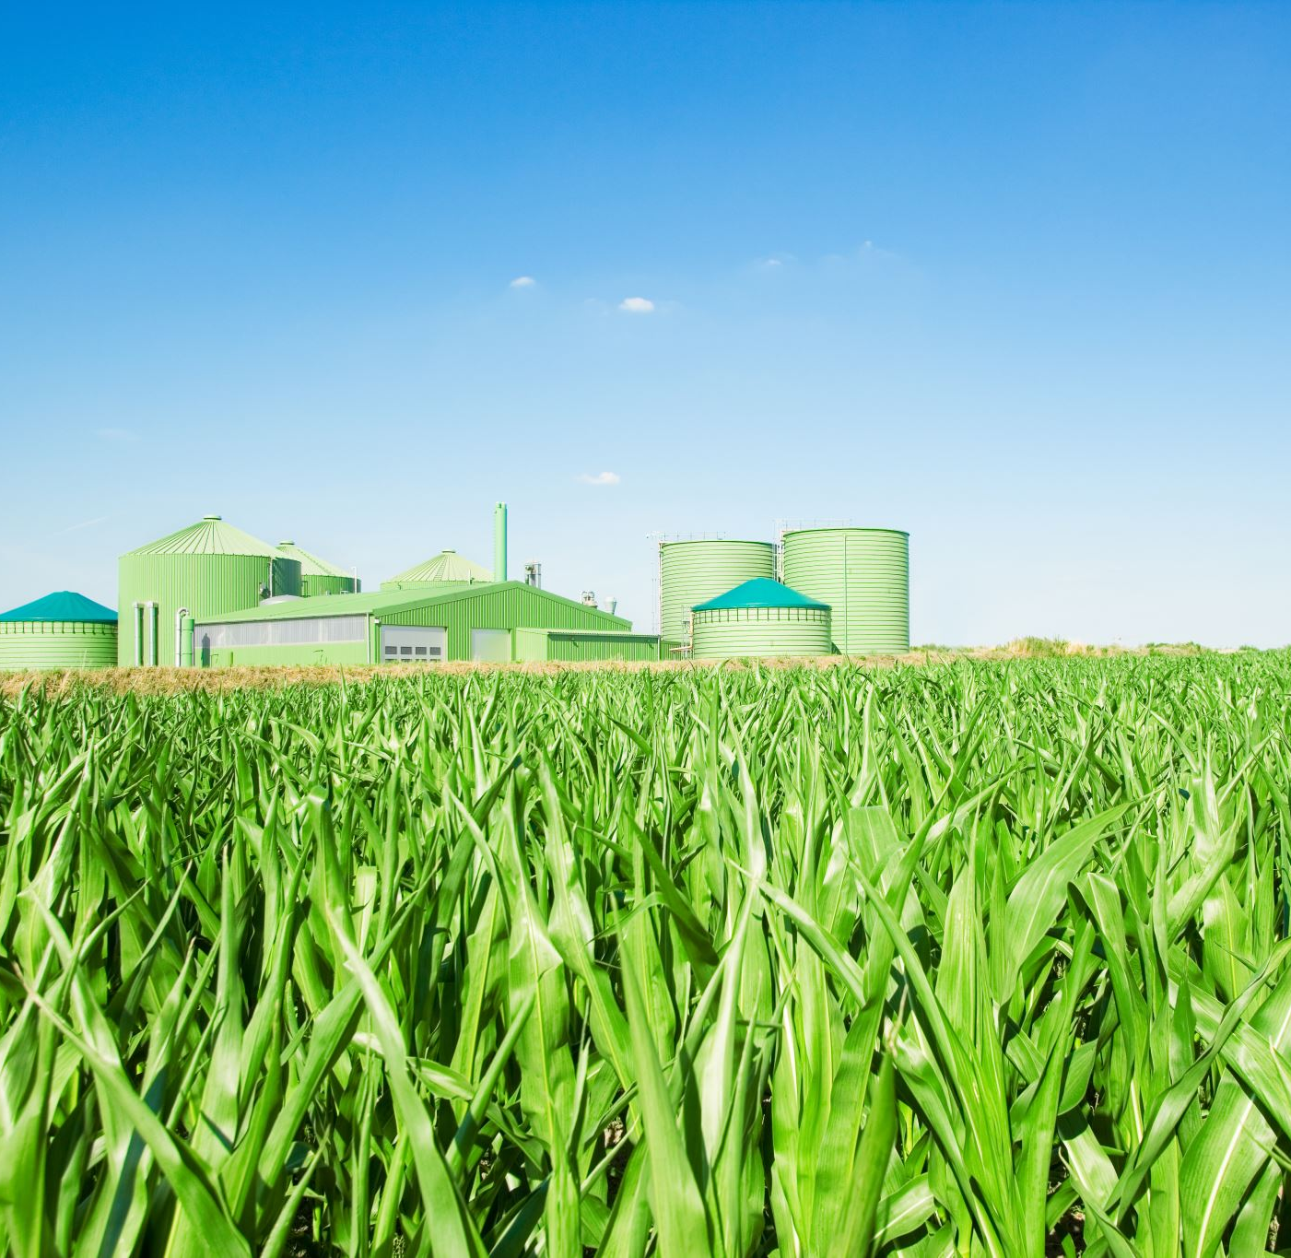
SMART AGRICULTURE
Laura Lemmi

Slide 2
Introduction
The application aims to provide functionalities for:
Monitoring a smart garden
Controlling the garden devices remotely
The system must be able to detect temperature and humidity data, trigger the switching on or off the light and sprinkler devices.
The status of the devices must be automatically set by the system or by the user through the interface, based on the configuration status.

Slide 3
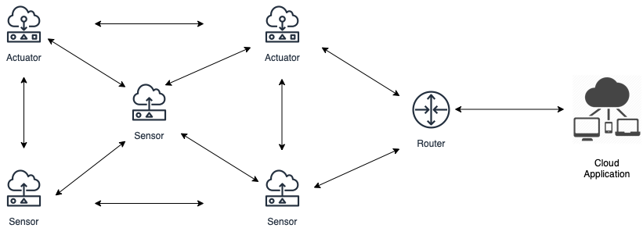
Architecture
Sensors
Actuators
Border Router
Cloud Application

Slide 4
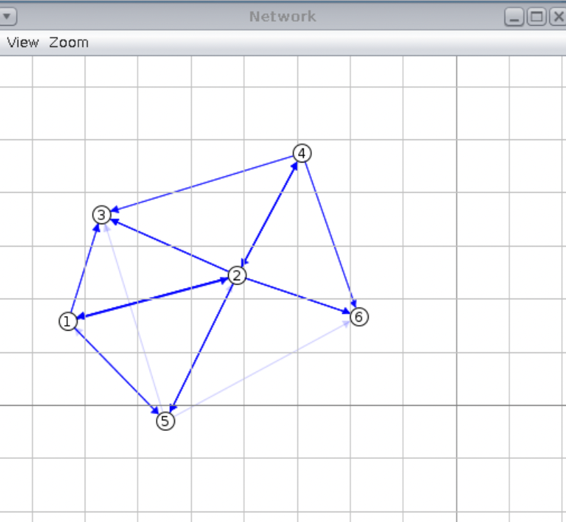
Functionalities
Each device in WSN, except for the BR, can be configured for acting as:
Sensor
Actuator
Sensor and Actuator
After the configuration each device registers to the cloud application, which can then access the exposed resources

Slide 5
Resources
Cloud Application exposes the “Registration” resource
"coap://[fd00::1]:5683/registration"
Sensors expose:
Temperature "coap://[nodeAddress]:5683/temperature"
Humidity "coap://[nodeAddress]:5683/humidity”
Actuators expose:
Light "coap://[nodeAddress]:5683/light"
Sprinkler "coap://[nodeAddress]:5683/sprinkler"
Both sensors and actuators expose a non observable resource:
Unregister "coap://[nodeAddress]:5683/unregister"

Slide 6
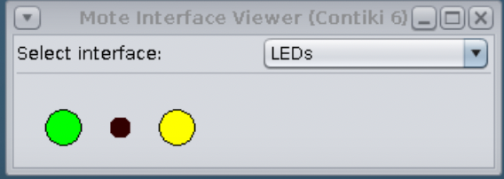
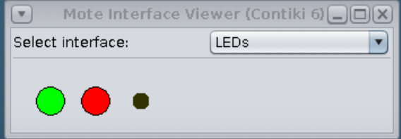
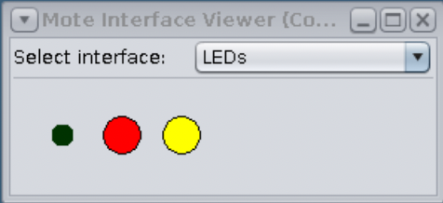
Actuator Nodes
Each actuator shows the status of its resources (light and sprinkler) through the LEDS
Light: ON
Sprinkler: ON
Light: OFF
Sprinkler: ON
Light: ON
Sprinkler: OFF

Slide 7
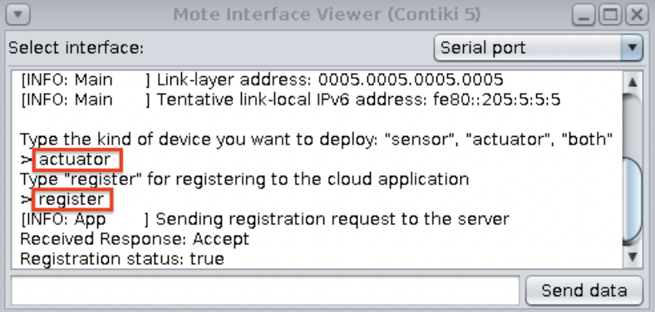
Simulation
At startup nodes must be configured as:
Sensors
Actuators
Both
a POST request to the cloud application “Registration” resource is sent
If the device is configured for acting as an actuator, leds must be set

Slide 8
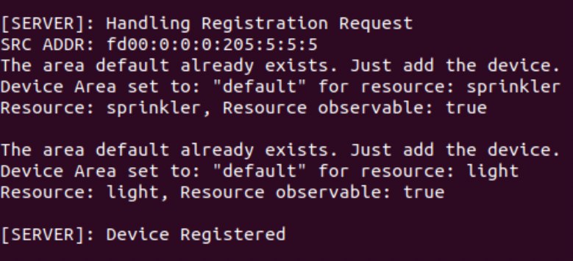
Simulation
Cloud Application registers the device:
It stores
its address
the exposed resource
the resource status in case of actuator
It puts the device in the default area
It assigns to the device a unique ID
New areas can be defined and devices can be moved there

Slide 9
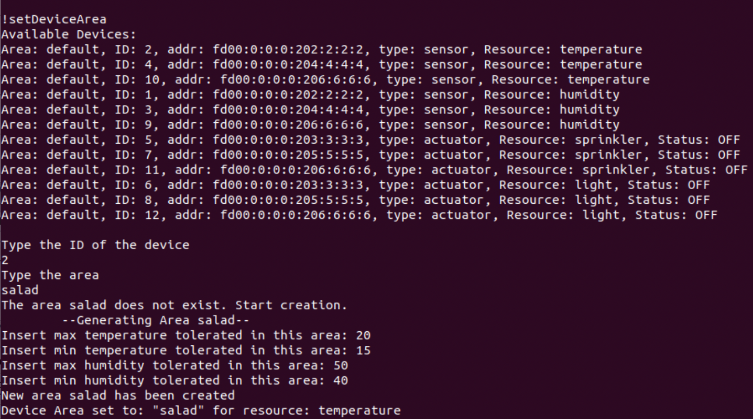
Simulation – Define Areas
New areas can be defined and devices can be moved there
Splitting the network in areas allow to manage devices differently based on the area condition

Slide 10
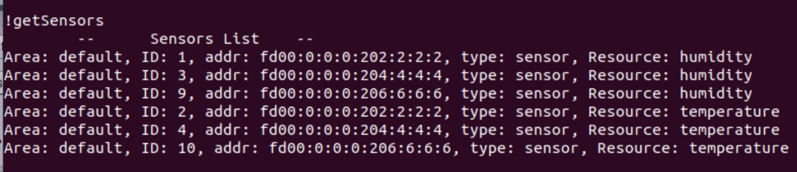
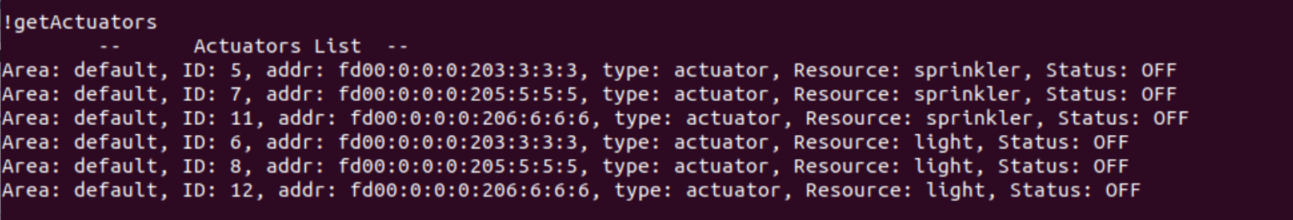
Simulation
From the application you can get the sensors and actuators registered
Their resources
The area where they are located

Slide 11
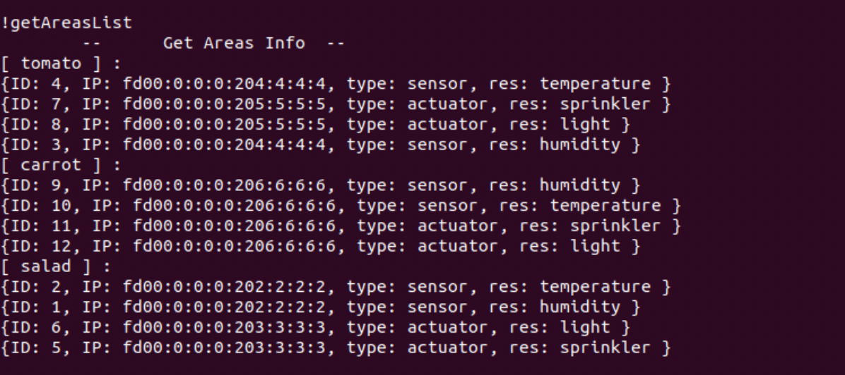
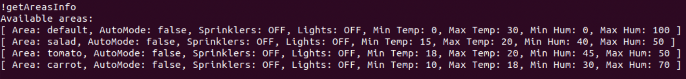
Simulation
From the application you can get the areas and its characteristics

Slide 12
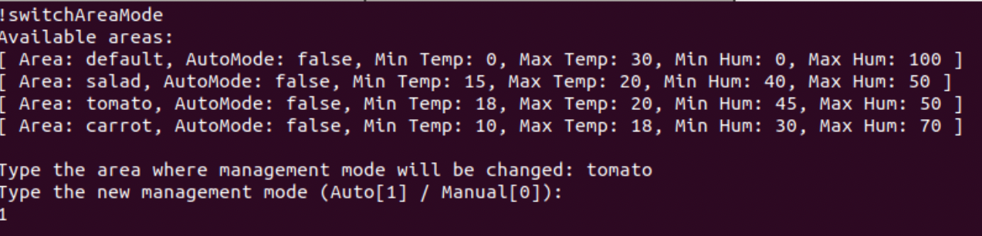
Simulation
Each node periodically monitors its resources and reports the monitoring to the subscribed clients
Cloud application, for each registered and observable device, received periodically updates
Cloud application can be managed:
Automatically
Manually

Slide 13
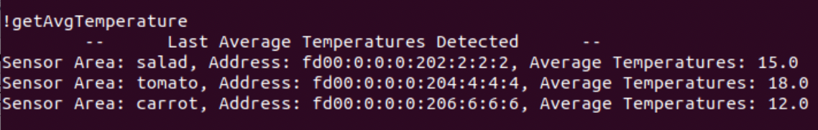
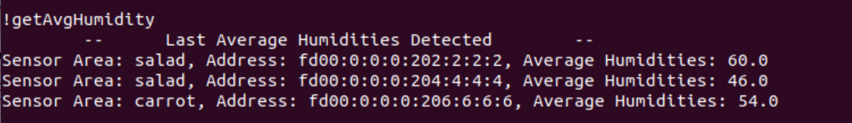
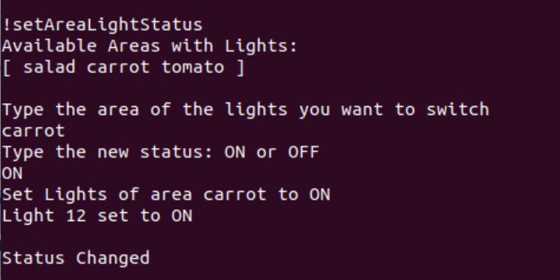
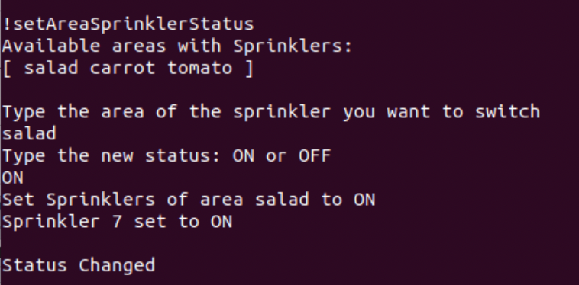
Simulation – Manual Management
User can retrieve the average of the monitored resources
Can decide to put ON/OFF the actuator resources in a certain area

Slide 14
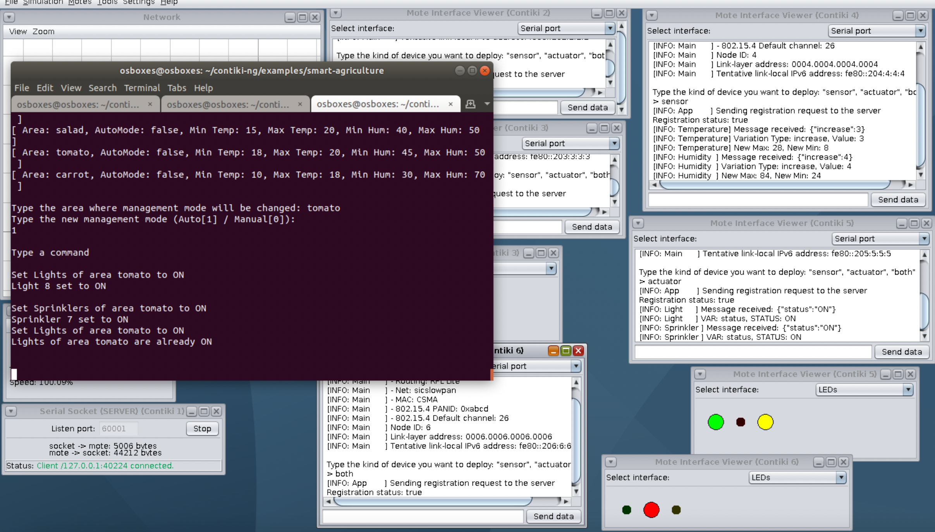
Simulation – Automatic Management
The system monitors the average temperature and humidity for each sensor
If a temperature average is above/below the threshold
It puts ON/OFF the lights in the same area
If a humidity average is above/below the threshold
It puts ON/OFF the sprinklers in the same area

Slide 15
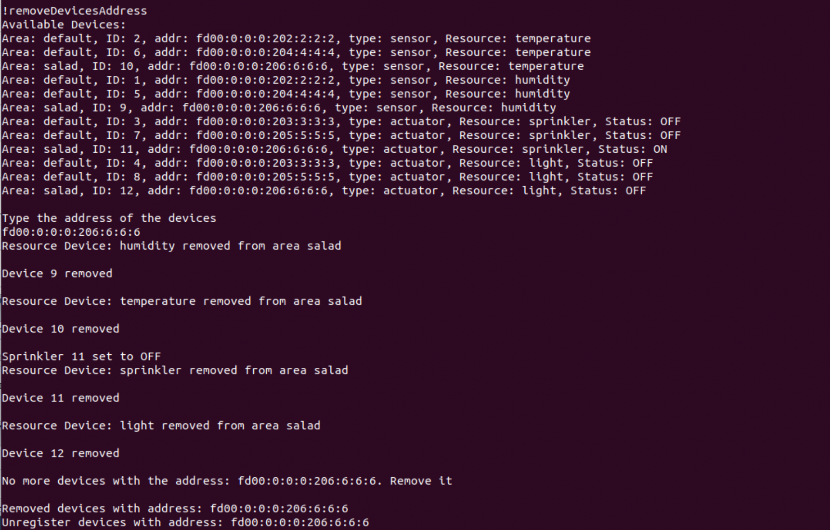
Simulation – Unregister Device
A device can be unregistered from the application
Later, it can be registered again if needed

Slide 16
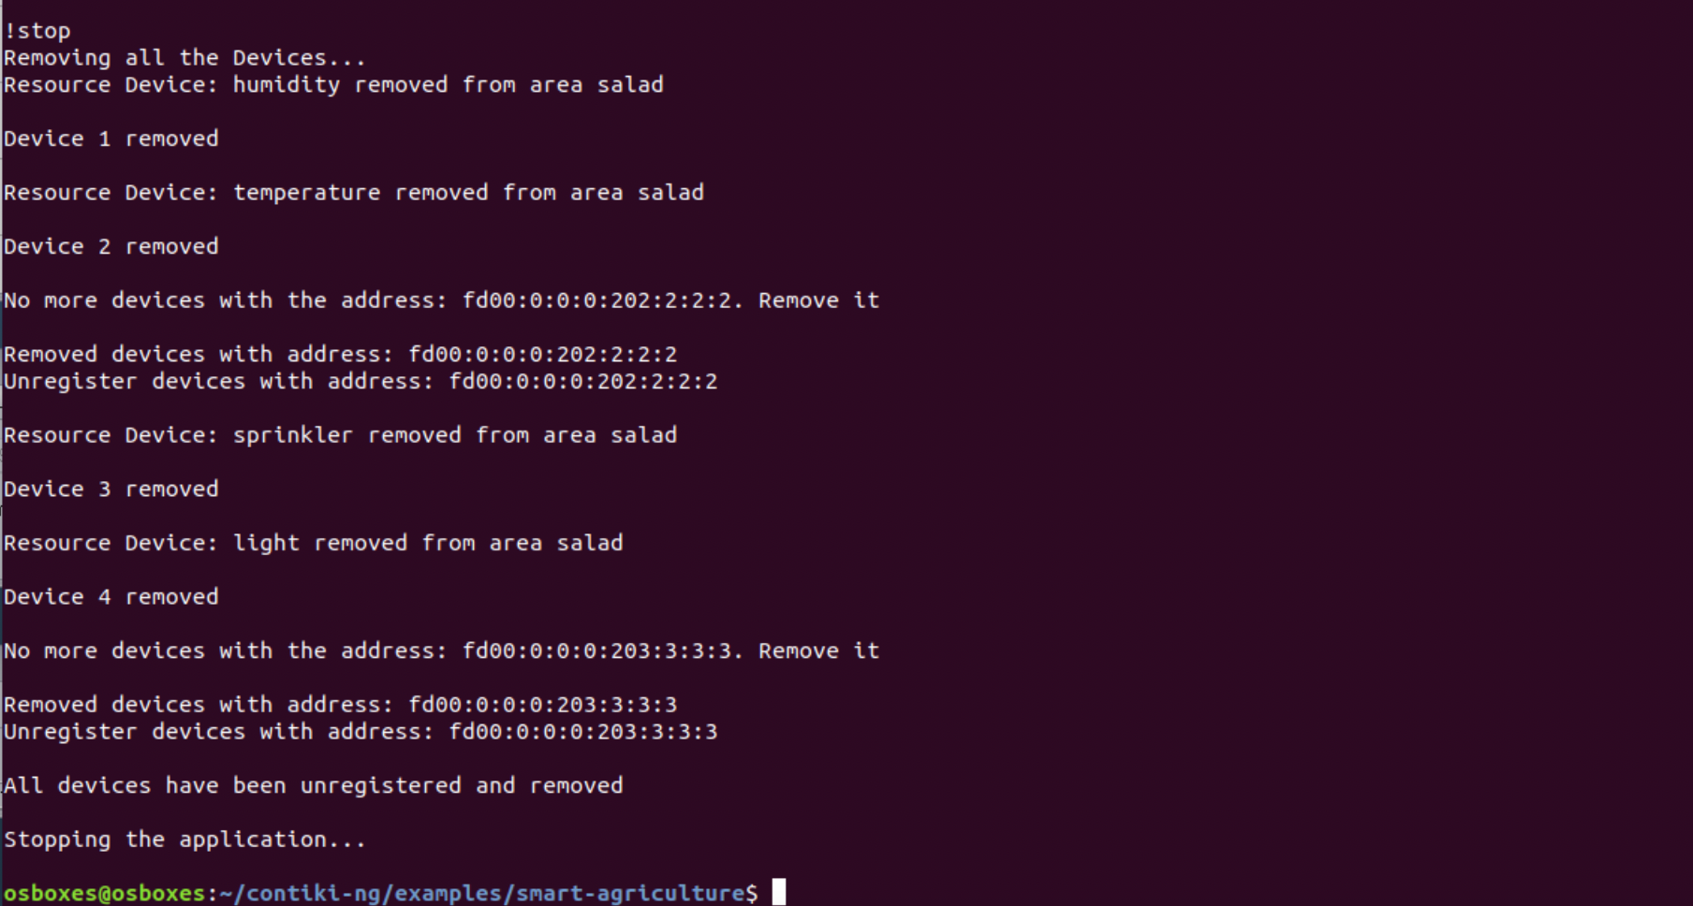
Simulation – Stop Application
To close the Cloud application
The devices are unregistered, a POST request to each is sent

